Slide 1


Gregory Siegfried
December 21st, 2021

Slide 2

Outline
Executive Summary 3
Introduction 4
Methodology 5
Results 15
Conclusion 44
<number>
Notes:
<number>

Slide 3
Executive Summary
Data collection, wrangling, and analysis have provided some insights on SpaceX. Features such as Launch Site, Payload Mass, and Orbit are associated with launch landing success. SpaceX has been increasing their landing success and are currently above 80%.
Testing model analysis puts accuracy at 83.3% on our SpaceX data using Support Vector Machine with a C of 1.0, a gamma around 0.0316 and a sigmoid kernel.
2

Slide 4
Introduction
SpaceX, our biggest competitor, have been able to reuse their Falcon 9 first stage boosters, to allow an entry price of $62 million for orbital launches.
Our company, Space Y, need to figure out if a booster will be reused to influence contract bidding.
Our question:
Can we determine the price of a SpaceX launch, based on being able to reuse the first stage?
3

Slide 5

4

Slide 6
Methodology
Data collection methodology:
Using the SpaceX REST API, and Wikipedia HTML Web Scraping.
Perform data wrangling:
One Hot Encoding converts categorical to numerical data, missing numerical values were averaged where appropriate, while unnecessary data was removed.
Perform exploratory data analysis (EDA) using visualization and SQL:
Bar charts, scatter plots, box plots and queries foe analysis.
Perform interactive visual analytics using Folium and Plotly Dash:
Folium maps for geography insights and Plotly dashboards for interactive insights.
Perform predictive analysis using classification models:
GridSearch for testing a variety of models and parameters for the best accuracy.
4
Notes:
<number>

Slide 7
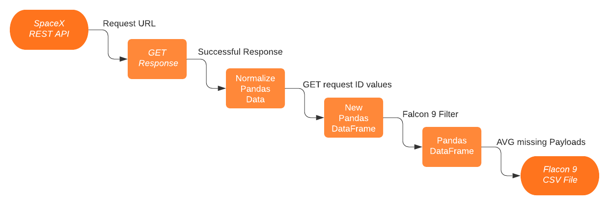
Data Collection – SpaceX API
https://github.com/siegfriedgreg/IBM-Data-Science-Coursera/blob/main/Capstone%20Data_Science/Lab%20-%201%20-%20SpaceX-API%20Calls.ipynb
6

Slide 8
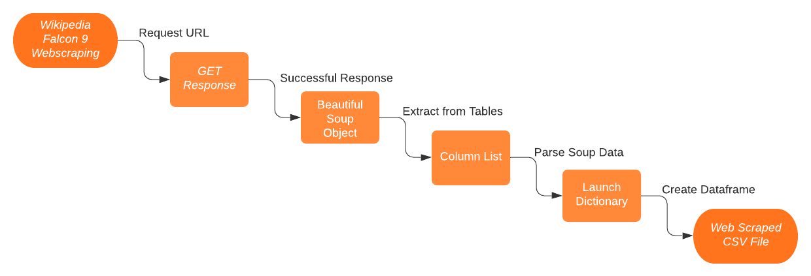
Data Collection - Scraping
https://github.com/siegfriedgreg/IBM-Data-Science-Coursera/blob/main/Capstone%20Data_Science/Lab%20-%202%20-%20SpaceX-Web%20Scraping.ipynb
7

Slide 9
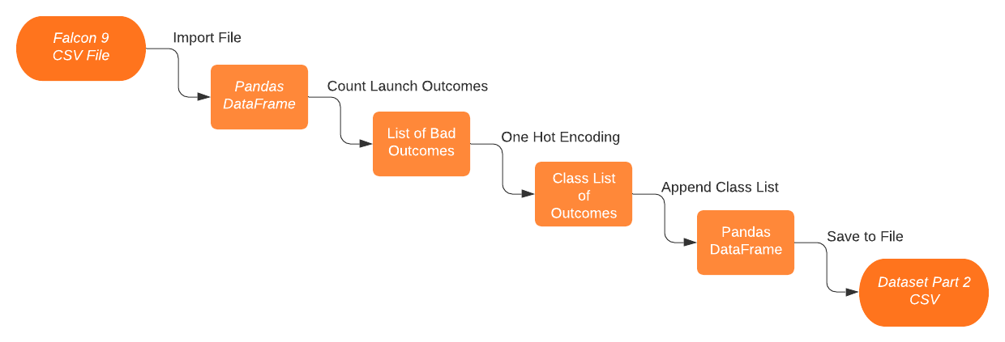
Data Wrangling
https://github.com/siegfriedgreg/IBM-Data-Science-Coursera/blob/main/Capstone%20Data_Science/Lab%20-%203%20-%20SpaceX-Data%20Wrangling.ipynb
8

Slide 10
EDA with Data Visualization
Using cat-plot, scatter plot, bar chart, and line plot, to visualize the data across Launch Site, Flight Number, Payload Mass, and Orbit.
All points being plotted are colored by a successful or unsuccessful launch
Examples: Slides 16-22
https://github.com/siegfriedgreg/IBM-Data-Science-Coursera/blob/main/Capstone%20Data_Science/Lab%20-%204%20-%20EDA%20Data%20Visualization.ipynb
9

Slide 11
EDA with SQL
Selected Items to List:
Distinct Launch Sites
Total or Average Payload Across Features
Booster Versions on Payload Ranges
Landing Outcomes for Dates
Examples: Slides 23-32
https://github.com/siegfriedgreg/IBM-Data-Science-Coursera/blob/main/Capstone%20Data_Science/Lab%20-%205%20-%20EDA%20SQL%20Queries.ipynb
10

Slide 12
Build an Interactive Map with Folium
Markers and Circles were added to aid in locating launch sites and zooming levels.
Marker Clusters were added to aid in visualizing launch outcomes for each site.
Feature Lines and Distances were added to show proximity to Cities, Rail Roads, Highways, and Coastlines.
Examples: Slides 33-36
https://github.com/siegfriedgreg/IBM-Data-Science-Coursera/blob/main/Capstone%20Data_Science/Lab%20-%206%20-%20Folium%20Map.ipynb
11

Slide 13
Build a Dashboard with Plotly Dash
Selecting one or all launch sites you can:
1) see the launch outcomes as a percentage in a pie chart.
2) see the launch outcomes per booster across all payload ranges, using a slider to narrow down values in a scatter plot.
Examples: Slides 37-40
https://github.com/siegfriedgreg/IBM-Data-Science-Coursera/blob/main/Capstone%20Data_Science/Lab%20-%207%20-%20SpaceX%20Dash%20App.py
12

Slide 14
Predictive Analysis (Classification)
X features uses a data set where all values are numeric, or one hot encoded. Y features is the launch outcome column ‘Class’.
The X and Y features were used to train-test-split the data sets.
GridSearch was used to find the best parameters for K Nearest Neighbors, Logistic Regression, Decision Tree, and Support Vector Machine.
Examples: Slides 41-43
https://github.com/siegfriedgreg/IBM-Data-Science-Coursera/blob/main/Capstone%20Data_Science/Lab%20-%208%20-%20SpaceX%20Predictive%20Analysis.ipynb
13

Slide 15
Results
Exploratory Data Analysis:
Flight success has increased over the years, with the most recent (2020) being a slight decrease. Payloads over 8000 kg are successful, and those in certain orbits are also. Data discrepancies exists for API data and SQL data, the former has 3 launch sites and the latter has 4.
Interactive Data Analysis:
Certain launch sites show to be more successful (KSC LC-39A). Booster versions don’t show to be more successful than others.
Predictive Data Analysis:
Both Logistic Regression and Support Vector Machines obtained a score of 83.3%. Their respective training accuracies were, 82.1% and 84.8%, and they both performed the same with respect to their confusion matrices.
15
Notes:
<number>

Slide 16


Slide 17
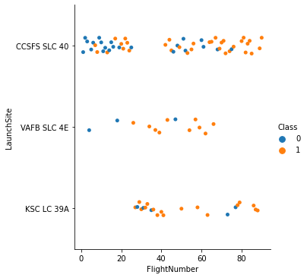
Flight Number vs. Launch Site
Class coloring indicates launch outcome.
0 is unsuccessful
1 is successful
Notice which sites are most active.
15

Slide 18
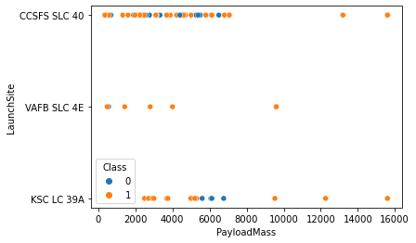
Payload Mass vs. Launch Site
Class coloring indicates launch outcome.
0 is unsuccessful
1 is successful
Notice which payload masses are most used at a site.
17

Slide 19
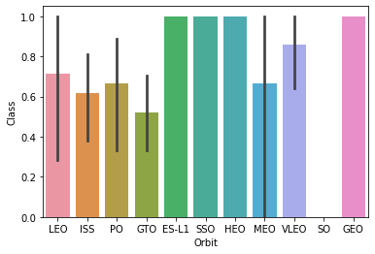
Orbit Type vs. Success Rate
Notice which orbit destinations are the more successful, and ones that have the most variability.
18

Slide 20
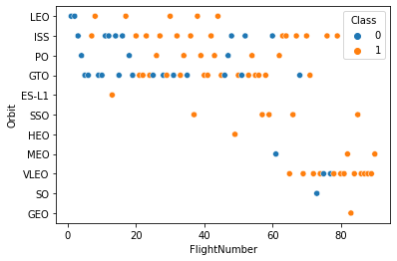
Flight Number vs. Orbit Type
Coloring indicates the launch outcome.
0 is unsuccessful
1 is successful
Notice, that few orbit destinations are without a successful landing.
19

Slide 21
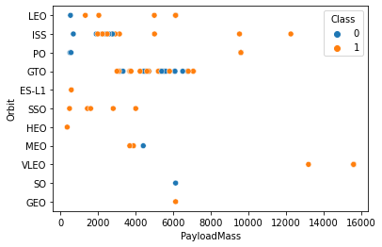
Payload Mass vs. Orbit Type
Coloring indicates landing outcomes.
0 is unsuccessful
1 is successful
Notice the payload ranges for particular orbit destinations.
20

Slide 22
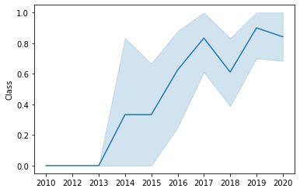
Launch Success Yearly Trend
Notice the trend from 2013 to 2019 increased in success. 2020 looks to be on a down trend.
21

Slide 23
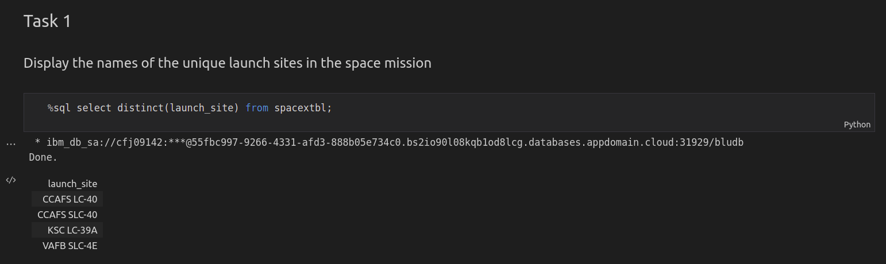
All Launch Site Names
22

Slide 24
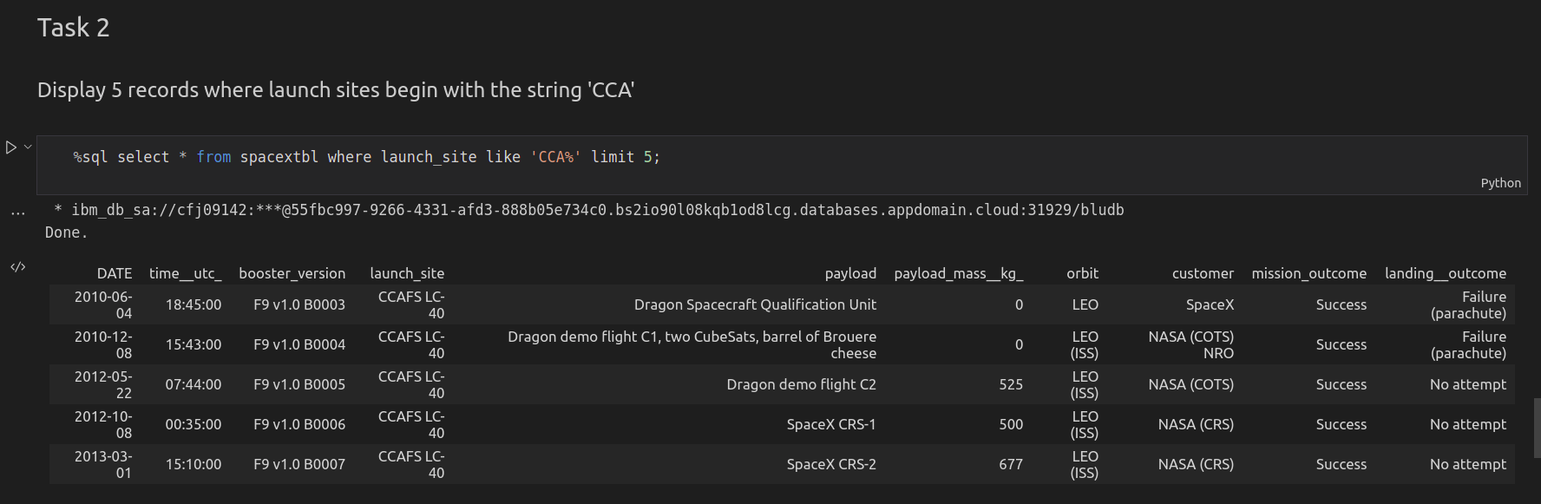
Launch Site Names Begin with 'CCA'
23

Slide 25
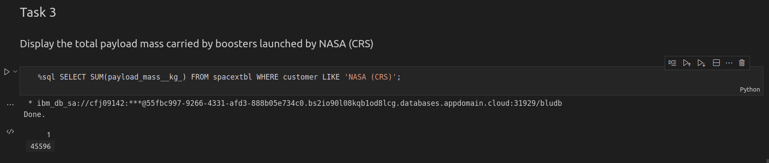
Total Payload Mass
24

Slide 26
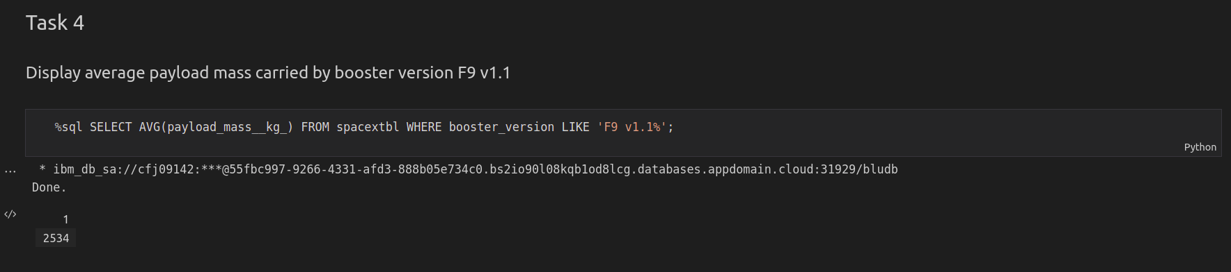
Average Payload Mass by F9 v1.1
25

Slide 27
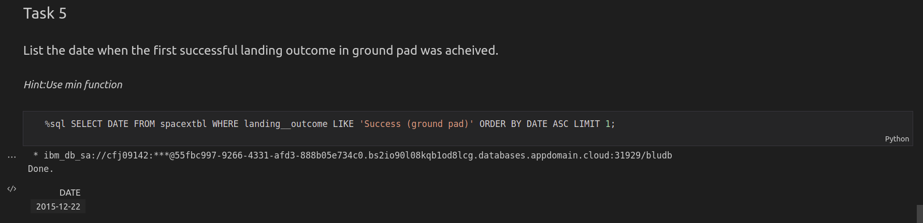
First Successful Ground Landing Date
26

Slide 28
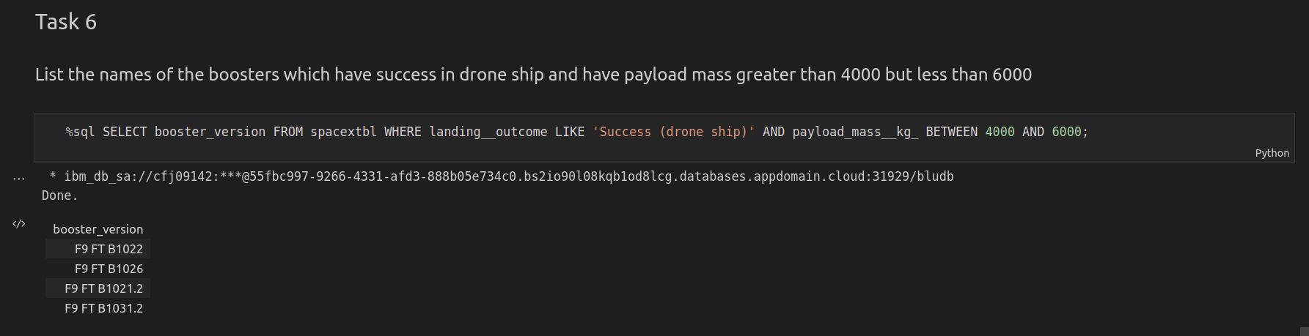
Successful Drone Ship Landing with Payload between 4000 and 6000
27

Slide 29
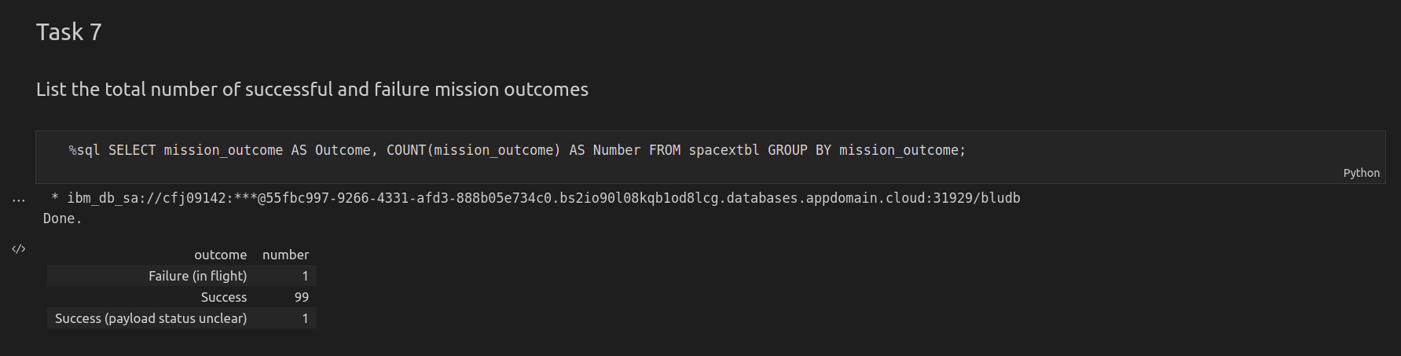
Total Number of Successful and Failure Mission Outcomes
28

Slide 30
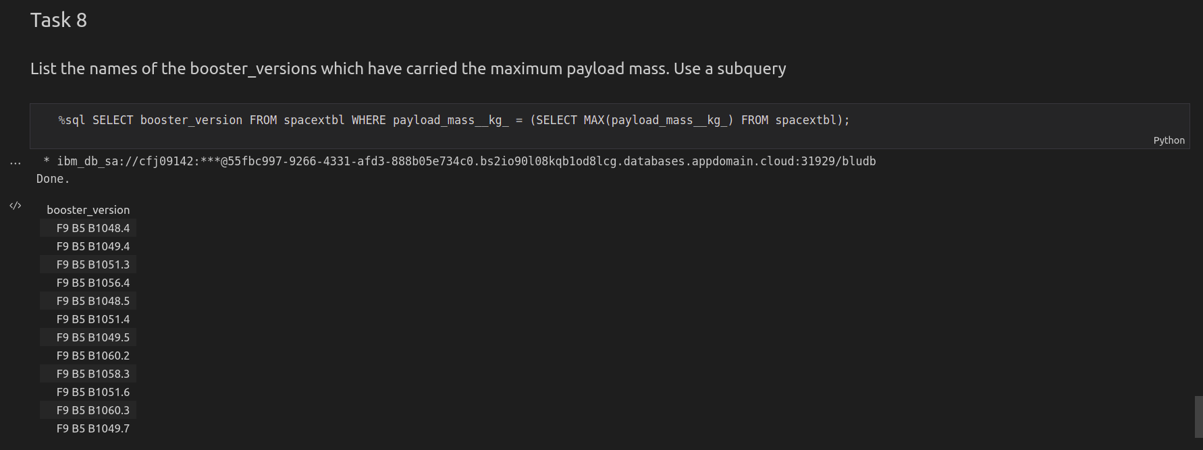
Boosters Carried Maximum Payload
29

Slide 31
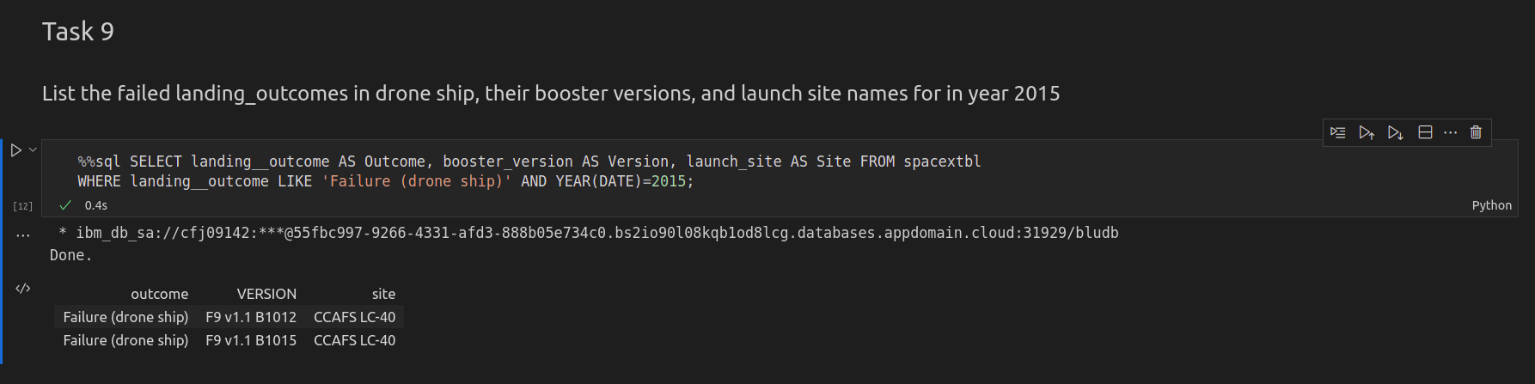
2015 Launch Records
30

Slide 32
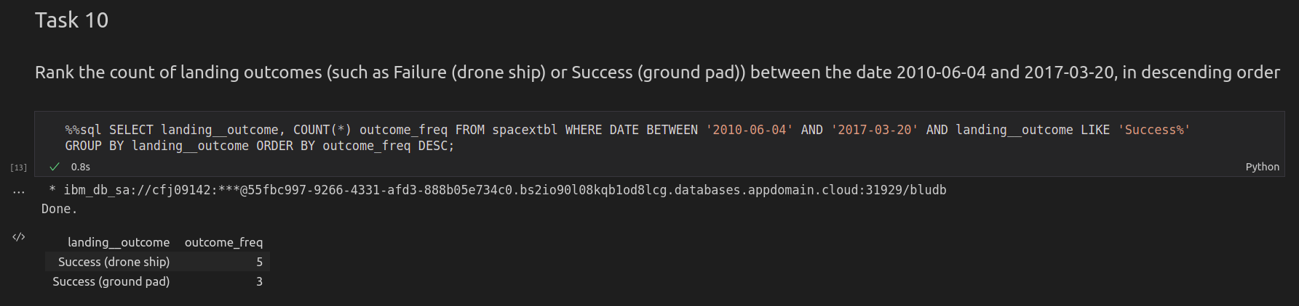
Rank Landing Outcomes Between 2010-06-04 and 2017-03-20
31

Slide 33


Slide 34
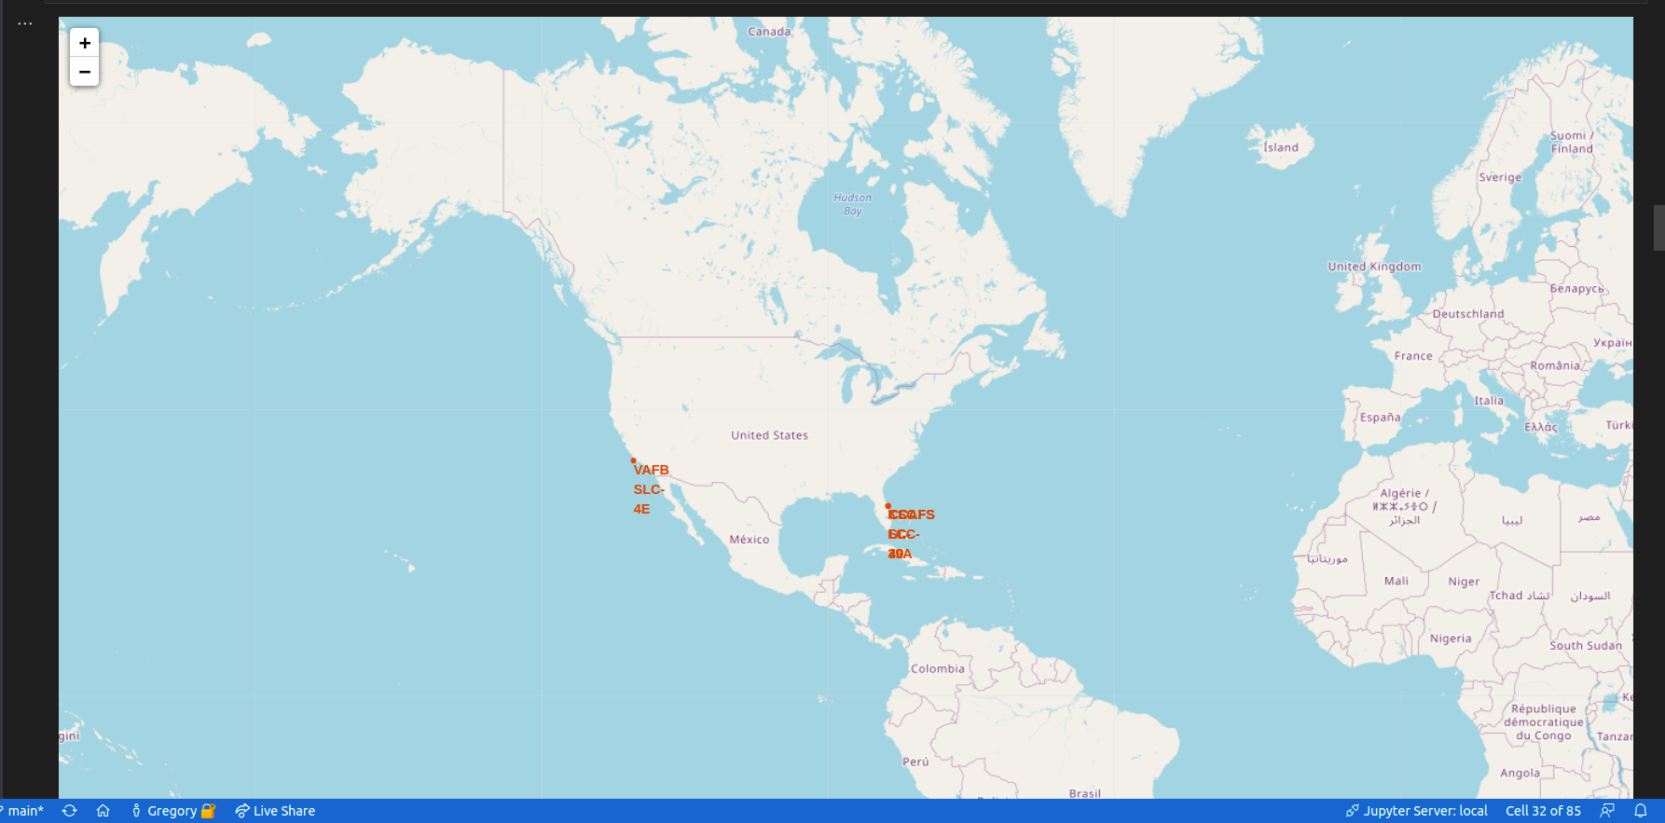
Folium Map - Launch Sites
Global screen shot of folium map with launch site locations.
32

Slide 35
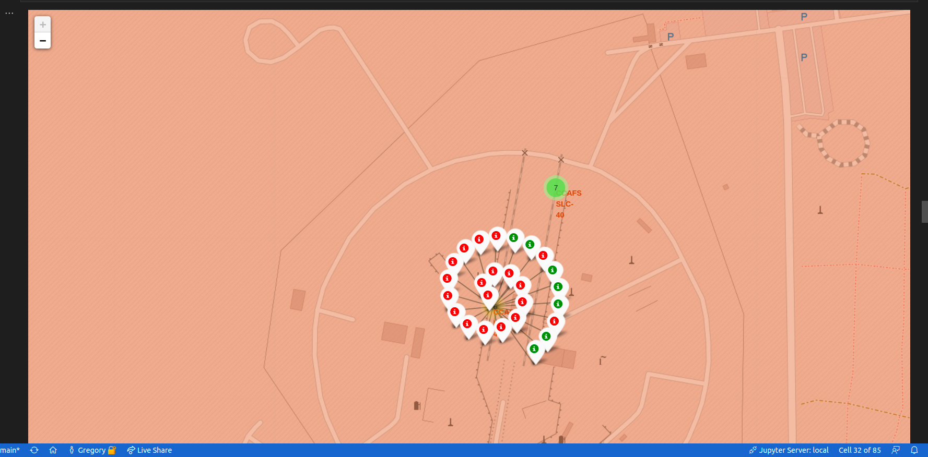
Folium Map – Launch Outcome Markers
Launch outcome markers for site: CCAFS LC-40
34

Slide 36
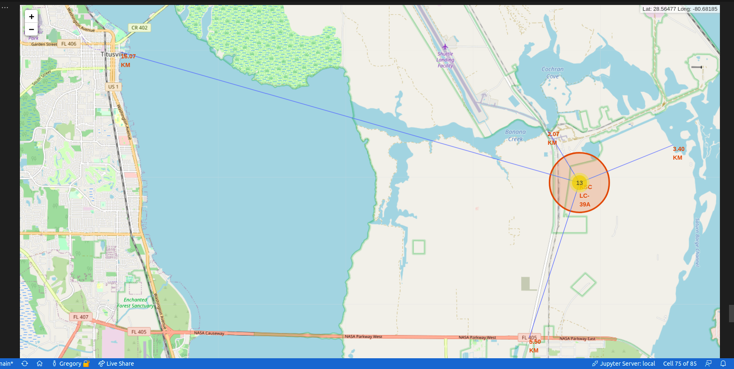
Folium Map – Local Feature Markers
Locations of features around site: KSC LC-39A
35

Slide 37


Slide 38
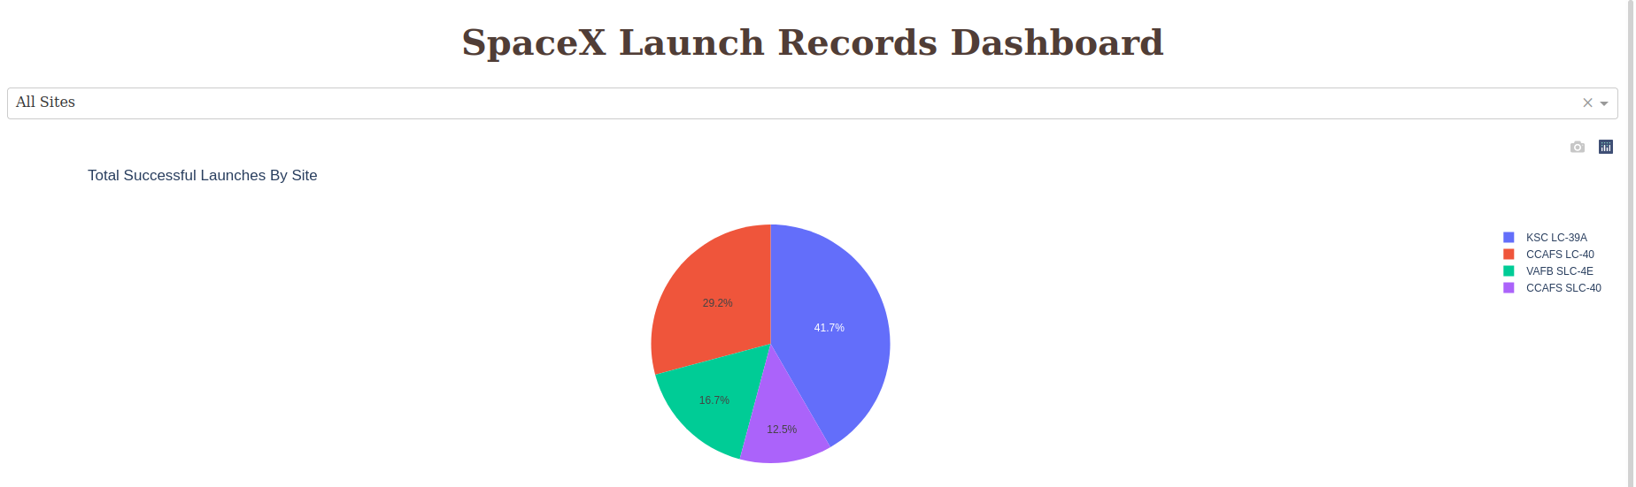
Dash – Successful Outcome by Site
Successful landings are shown across all launch sites
36

Slide 39
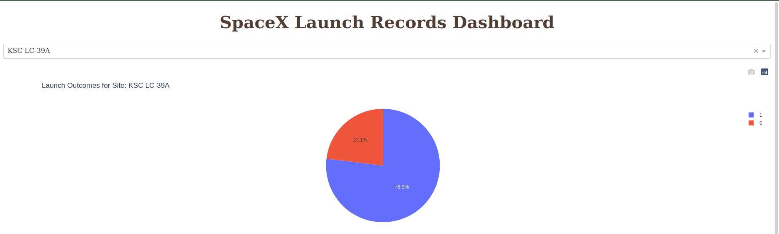
Dash – Most Successful Site
Successful landings are coded 1, and Unsuccessful as 0
38

Slide 40
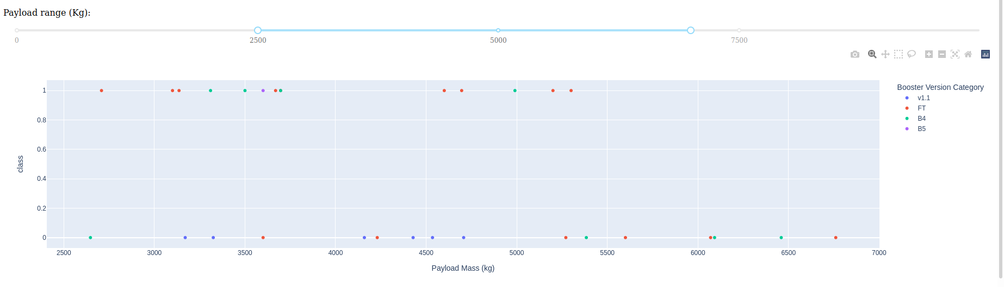
Dash – Payload Mass vs. Launch Outcome
All sites with payload range between 2500 to 7000 kg, booster version by color.
39

Slide 41


Slide 42
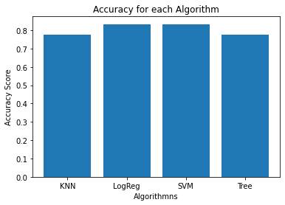
Classification Accuracy
The two algorithms that both performed the same on testing data were Logistic Regression (LogReg) and Support Vector Machine (SVM).
When taking training accuracy into account, SVM performed better than LogReg at 84.8% to 82.1% respectively.
40

Slide 43
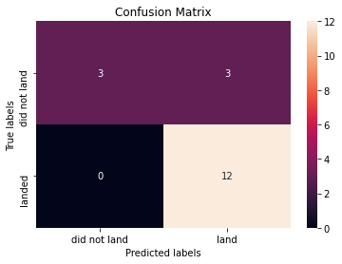
Confusion Matrix
Both Support Vector Machine and Logistic Regression had the same outcome with respect to their Confusion Matrix.
The results show that each algorithm had three false positives, where it predicted a successful landing and that was not the case.
42

Slide 44
Conclusions
Support Vector Machine model with the best parameters: { 'C': 1.0, 'gamma': 0.03162277660168379, 'kernel': 'sigmoid' }, had a training accuracy of 84.8% and testing accuracy of 83.3%
Landing success increases with a payload mass greater than 8000 kg.
Landing success has increased from 2013 to 2019, and 2020 is the most recent decrease which currently sits above 80%.
Landing success increases when launched from certain sites like KSC LC-39A.
Landing success increases with certain orbit destinations.
43

Slide 45


